Slide 1
Group Project Solution
Group 10
Notes:
Maximum floor time: 30 mins

Slide 2
Team Organisation
Product Owner:
Chloe Allen
Team 1
Robin Watson (lead)
Andrew Lamnea
William Cooter
Team 2
Ellis Doran (lead)
Sean Tomlinson
Ethan Kelly
Notes:
During our initial build I took on the role of the client as Product Owner, so I could direct the team following the client meeting.
I then divided the teams with a larger group doing some of the potentially more difficult work, a smaller group working on the next step of the project as we discussed in the planning meetings after the client meeting.
There were also two group members I put on back-end set up.
Their role within the group was to handle the groups back-ups and Git repository, so our saved work was protected.

Slide 3
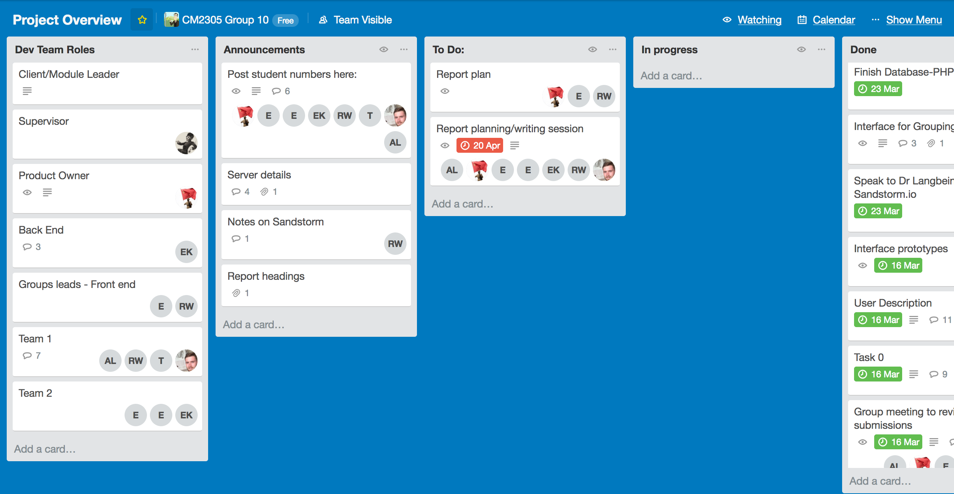
Team Management

Slide 4
Improved criteria
Add tools for student development
Sandstorm.io
Fix security flaws
Improve security on storing student data
Develop file upload system more
Create a more user friendly interface
PHP and front-end development

Slide 5
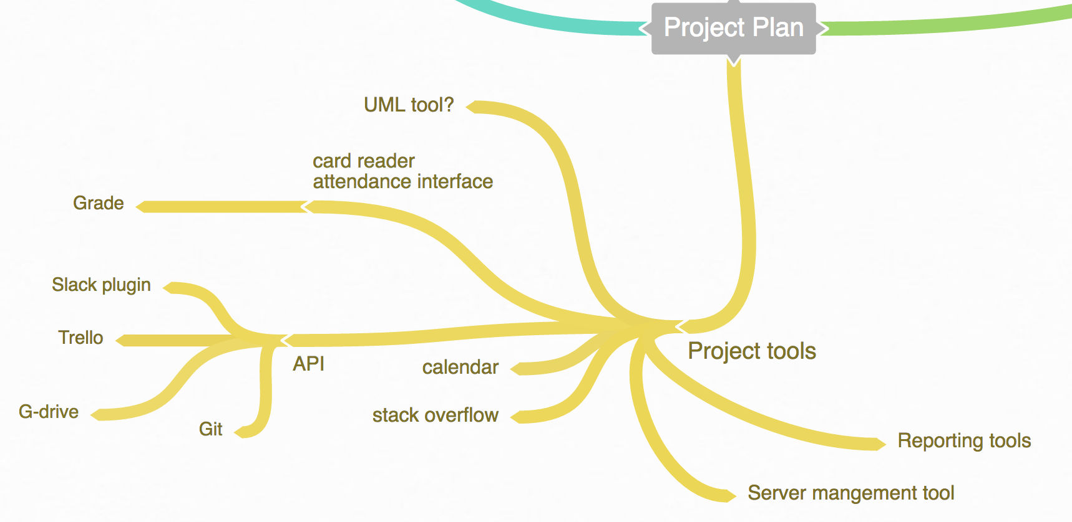
Current focal point
Notes:
The Project Tools thread is a little crowded but essentially includes a large selection of tools. These tools we will revisit in future iterations of the project

Slide 6
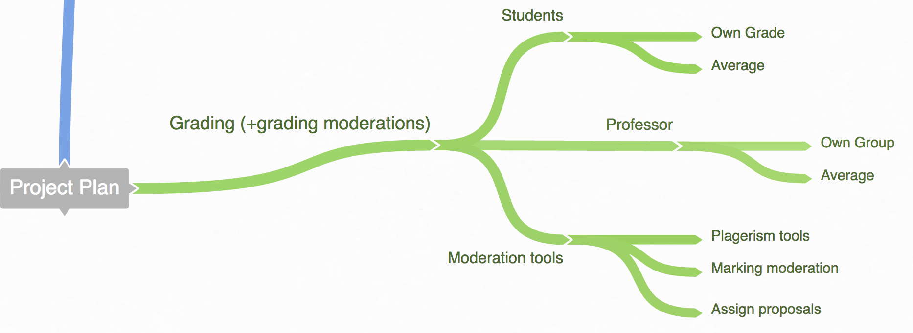
Future focal point
Notes:
These are the grading tools suggested for the project, they are going to be the focus of later projects.

Slide 7
Sandstorm development issues
Notes:
This is how we imagined our final, combined system to work together. To deal with workload in the team we split the problem further into 3 equally sized chunks:
Login system
Upload system
Retrieve/download system
The team also split into 2 subgroups so that two members could work on a problem at any given time.

Slide 8
Sandstorm development issues
Notes:
This is how we imagined our final, combined system to work together. To deal with workload in the team we split the problem further into 3 equally sized chunks:
Login system
Upload system
Retrieve/download system
The team also split into 2 subgroups so that two members could work on a problem at any given time.

Slide 9
Sandstorm development issues
Notes:
This is how we imagined our final, combined system to work together. To deal with workload in the team we split the problem further into 3 equally sized chunks:
Login system
Upload system
Retrieve/download system
The team also split into 2 subgroups so that two members could work on a problem at any given time.

Slide 10
Team 1 – Limitations

Slide 11
Sandstorm testing
Notes:
And now for a quick demo of our application.

Slide 12
Front end development

Slide 13
Front end challenges

Slide 14
Front end challenges

Slide 15
Front end limitations

Slide 16
Front end testing

Slide 17
Security development

Slide 18
Legal/Social

Slide 19
Summary

Slide 20
Any Questions?

